Slide 1

ANALYSIS ON H1B VISA PETITIONS USING HADOOP
Presented By – Suman Bhamu

Slide 2
DATASETS
Transactional dataset
Olympic dataset
Movie dataset
IPL Matches dataset
Petrol dataset
Real State dataset

Slide 3

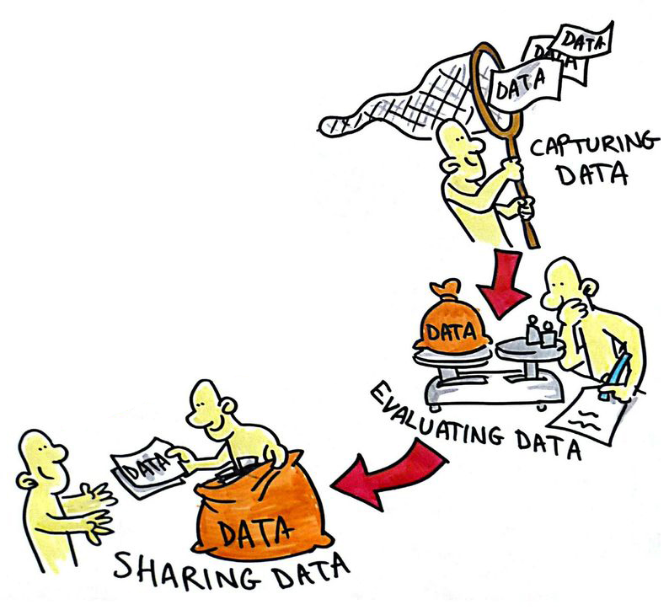




Big Data & It’s Problems

Slide 4

Main Sources of Data:
These data come from many sources like
Social networking sites
E-commerce site
Weather Station
Telecom company
Share Market

Slide 5

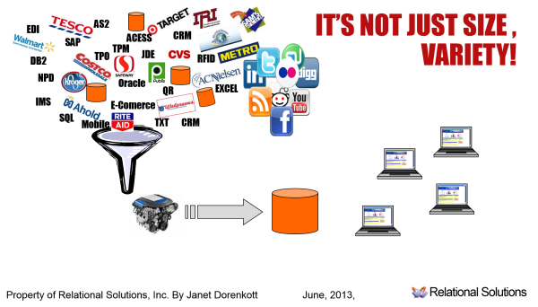




Characteristics of Big Data

Slide 6


Data exchange for every "1" minute
No one has ability to stop data
which is generated across the globe
but the main thing is how to handle
this data using traditional ways.

Slide 7
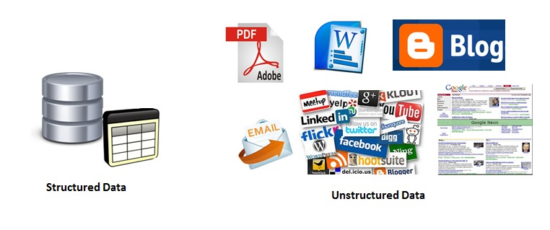
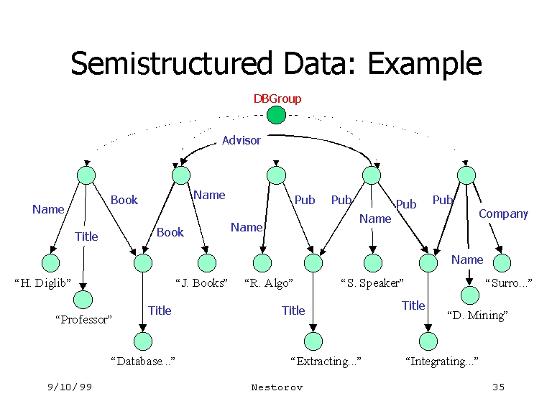
Categories Of 'Big Data'

Slide 8

What is Hadoop ?
Hadoop is an open source, Java-based programming framework that supports the processing and storage of extremely large data sets in a distributed computing environment. It is part of the Apache project sponsored by the Apache Software Foundation.

Slide 9
Advantages of Hadoop
Ability to store and process huge amounts of any kind of data. With data volumes and varieties constantly increasing, especially from social media and the Internet of Things (IoT), that's a key consideration.
Computing power. Hadoop's distributed computing model processes big data fast. The more computing nodes you use, the more processing power you have.
Fault tolerance. Data and application processing are protected against hardware failure. If a node goes down, jobs are automatically redirected to other nodes to make sure the distributed computing does not fail. Multiple copies of all data are stored automatically.
Flexibility. Unlike traditional relational databases, you don’t have to preprocess data before storing it. You can store as much data as you want and decide how to use it later. That includes unstructured data like text, images and videos.
Low cost. The open-source framework is free and uses commodity hardware to store large quantities of data.
Scalability. You can easily grow your system to handle more data simply by adding nodes. Little administration is required.

Slide 10
Introduction to HDFS
Namenode
NameNode is the centerpiece of HDFS.
NameNode is also known as the Master
NameNode only stores the metadata of HDFS – the directory tree of all files in the file system, and tracks the files across the cluster.
NameNode does not store the actual data or the dataset. The data itself is actually stored in the DataNodes.
Datanode
DataNode is responsible for storing the actual data in HDFS.
DataNode is also known as the Slave
NameNode and DataNode are in constant communication
Secondary Namenode
Secondary NameNode is a specially dedicated node in HDFS cluster whose main function is to take checkpoints of the file system metadata present on namenode.
It is not a backup namenode.

Slide 11
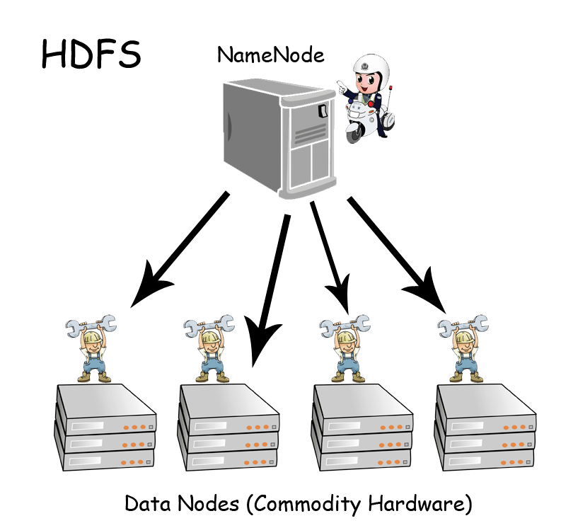
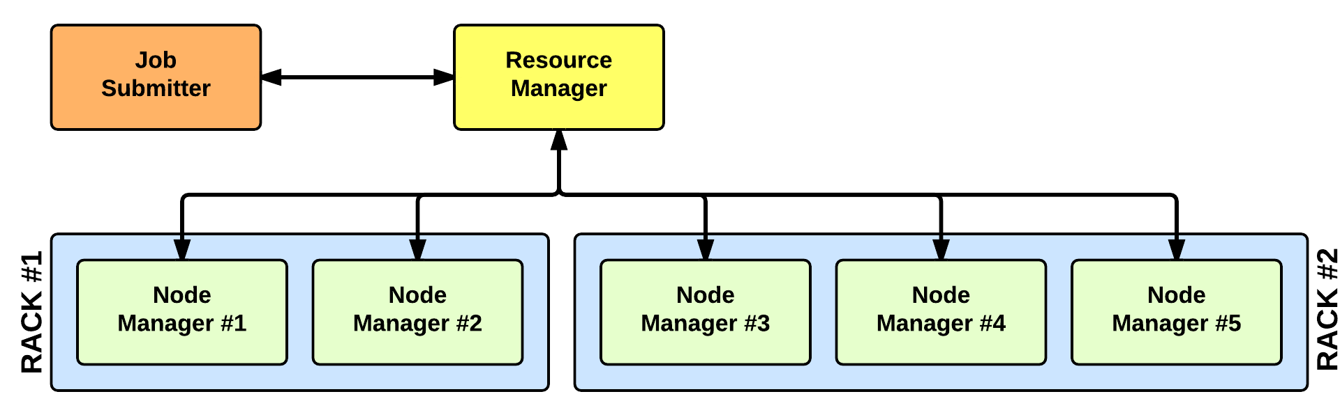
Main components of Hadoop 2.X
YARN

Slide 12
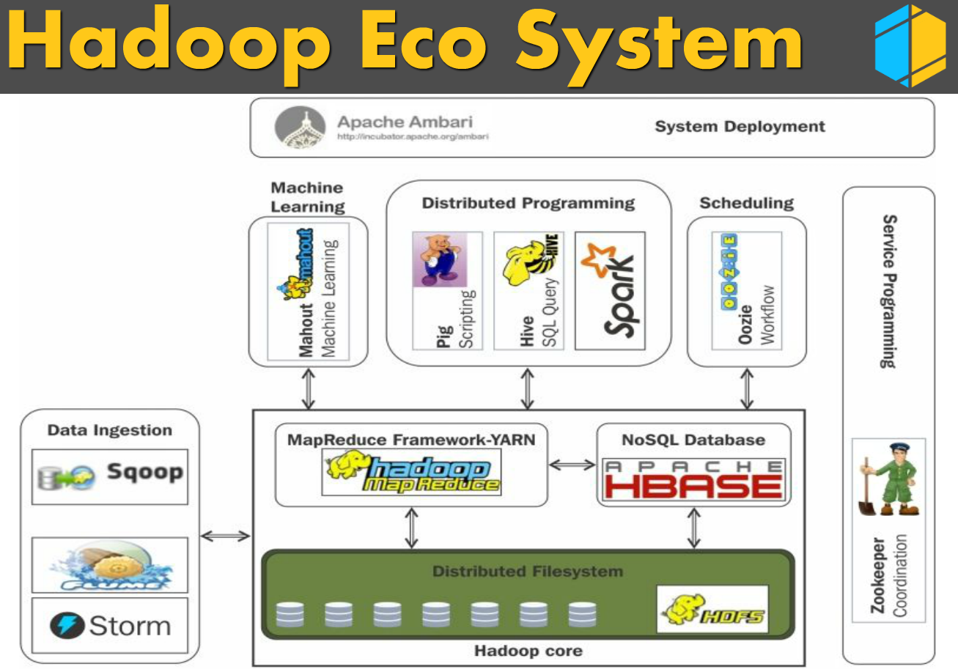

Slide 13
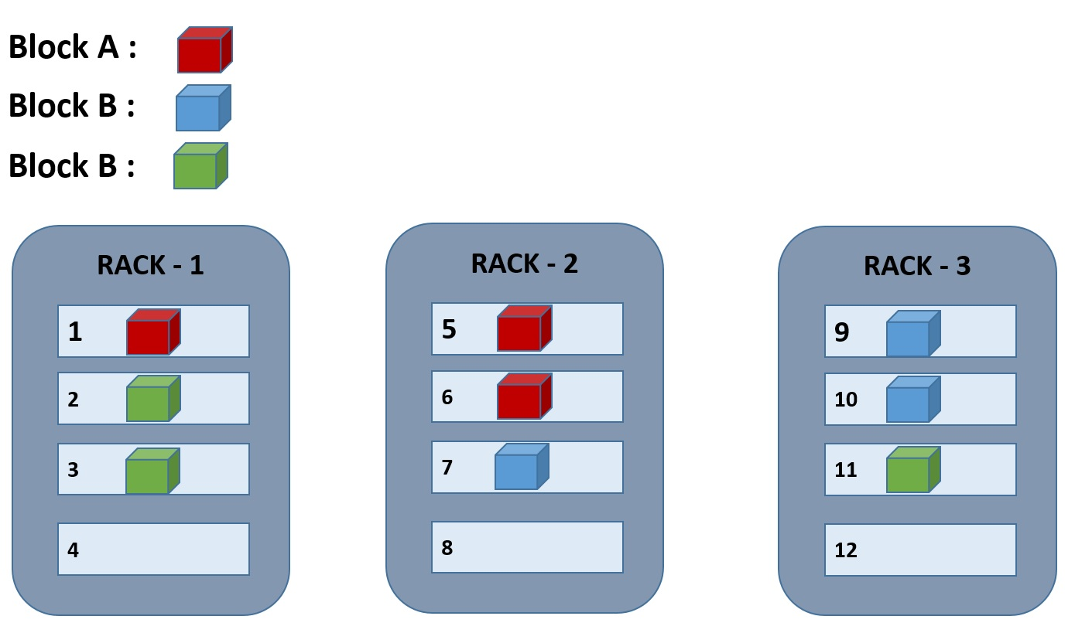
Rack Awareness

Slide 14
Apache MapReduce
MapReduce is a processing technique and a program model for distributed computing based on java. The MapReduce algorithm contains two important tasks, namely Map and Reduce.
Map takes a set of data and converts it into another set of data, where individual elements are broken down into tuples (key/value pairs).
Secondly, reduce task, which takes the output from a map as an input and combines those data tuples into a smaller set of tuples. As the sequence of the name MapReduce implies, the reduce task is always performed after the map job.

Slide 15
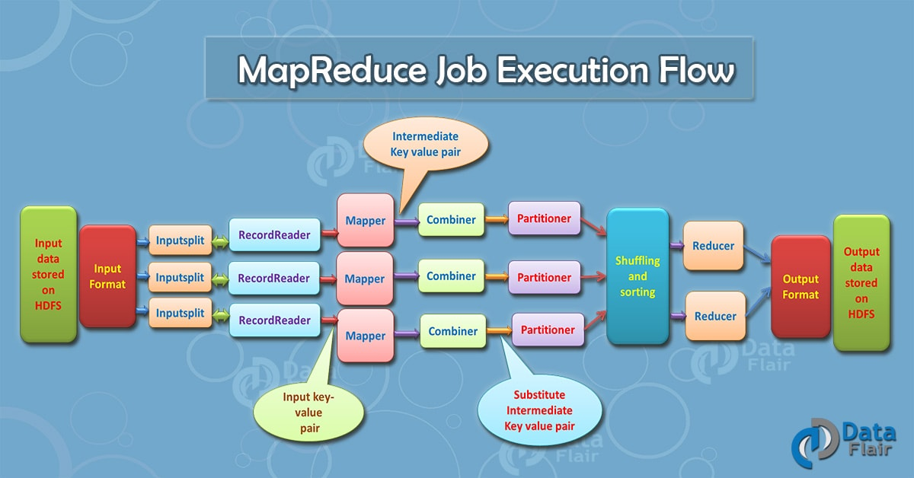

Slide 16
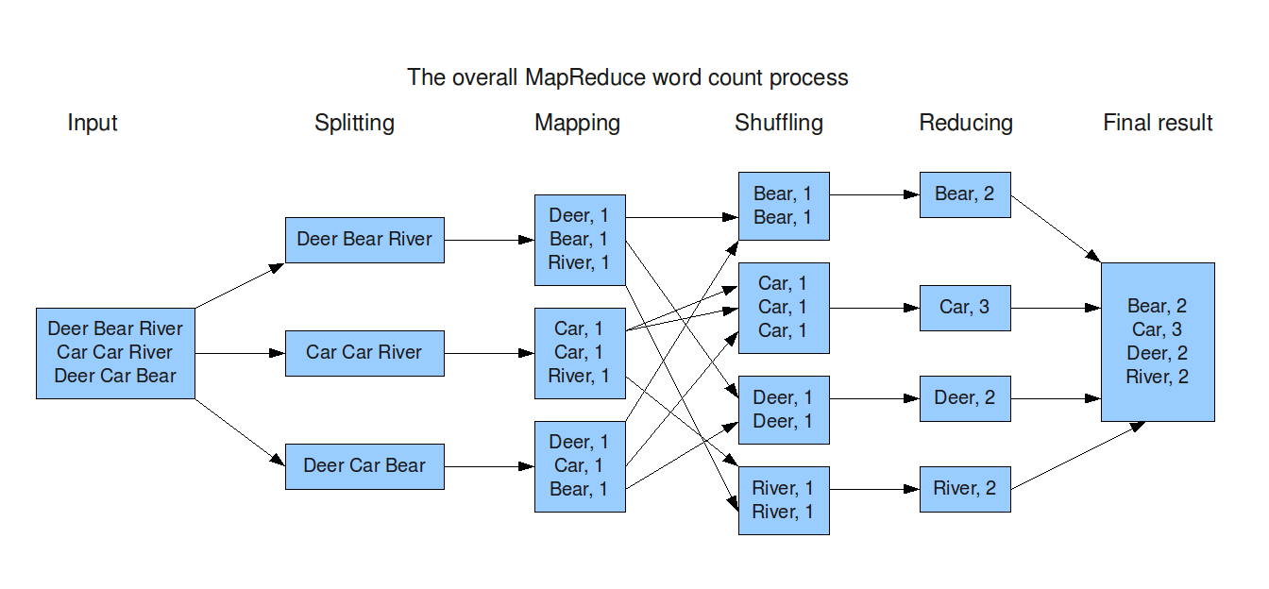

Slide 17

Apache Hive
Hive is a data warehouse system layer built on Hadoop which allows you to define a structure for your big data and simplifies analysis and queries with an SQL-like scripting language called HiveQL.
Hive uses a database to store metadata, but the data that hive process is stored in hdfs. Simply hive is nothing but which allows to run structured query on unstructured data.

Slide 18
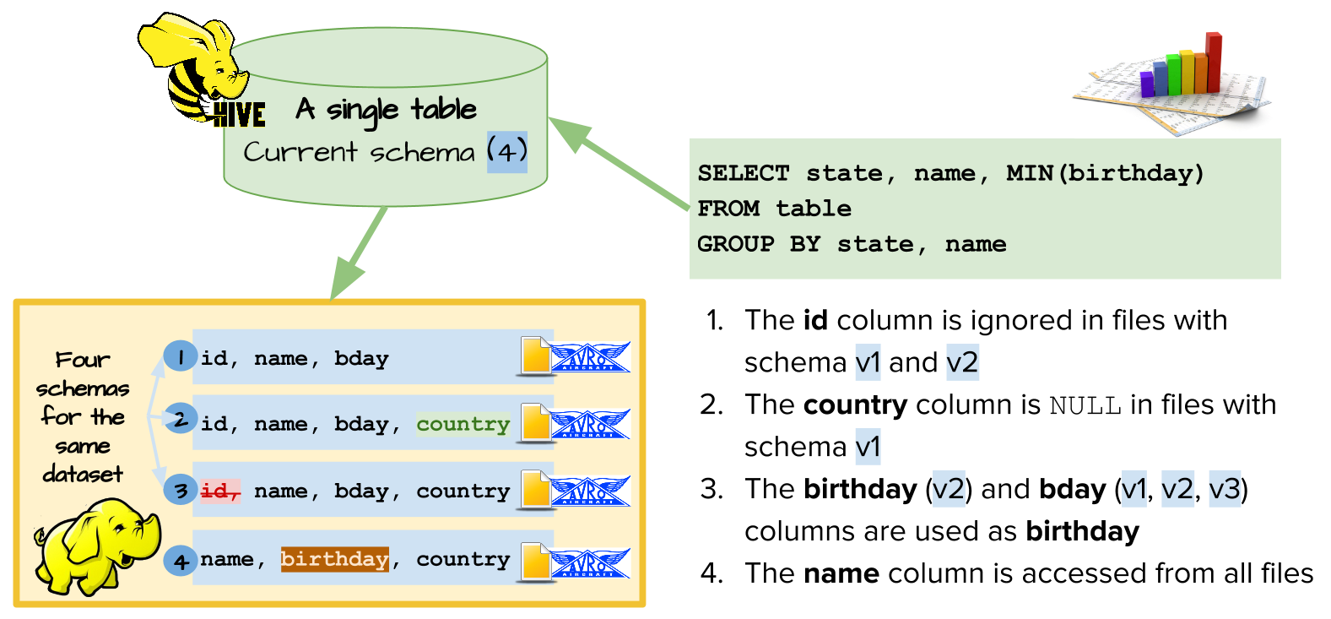

Slide 19

Apache pig
Pig is an in memory processing tool and also said to be data flow language which supports all data formats. In pig we have grunt shell and by default data type will be byte array. Pig provides a high-level language known as Pig Latin.

Slide 20
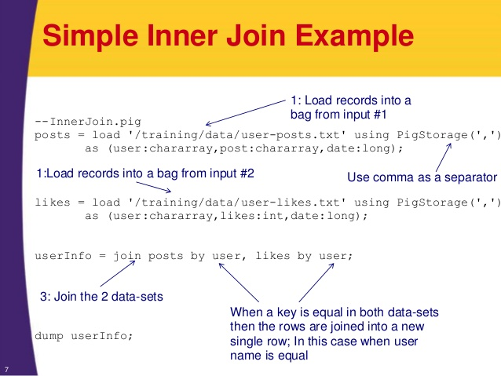

Slide 21
Components of Hadoop
Apache Flume. A tool used to collect, aggregate and move huge amounts of streaming data into HDFS.
Apache HBase. An open source, non relational, distributed database.
Apache Oozie. A server-based workflow scheduling system to manage Hadoop jobs.
Apache Sqoop. A tool to transfer bulk data between Hadoop and structured data stores, such as relational databases.
Apache Zookeeper. This is basically a centralized system that maintains – Configuration information Naming information Synchronization information.

Slide 22
Description of project (H1B – Case Study)
The H1B is an employment-based, non-immigrant visa category for temporary foreign workers in the United States.
For a foreign national to apply for H1B visa, an US employer must offer a job and petition for H1B visa with the US immigration department.
This is the most common visa status applied for and held by international students once they complete college/ higher education (Masters, Ph.D.) and work in a full-time position.
We will be performing analysis on the H1B visa applicants between the years 2011-2016
The dataset has nearly 3 million of records.
The dataset is unstructured form.

Slide 23
The columns in the dataset includes
s_no (no of the applicant)
case_status (certified, certified withdrawn, withdrawn, denied)
employer_name (Name of employer submitting labor condition application)
soc_name (the Occupational name associated with the SOC_CODE)
job_title (Title of the job)
full_time_position (Y = Full Time Position; N = Part Time Position)
prevailing_wage (Average wage paid to similarly employed workers
year (Year in which the H1B visa petition was filed)
worksite (City and State information of the foreign worker’s)
longitude (longitude of the Worksite)
latitude (latitude of the Worksite)

Slide 24
Project Analysis
1. Is the number of petitions with Data Engineer job title increasing over time?
2. Find top 5 job titles who are having highest growth in applications.
3. Which part of the US has the most Data Engineer jobs for each year?
4. Find top 5 locations in the US who have got certified visa for each year.
5. Which industry has the most number of Data Scientist positions?
6. Which top 5 employers file the most petitions each year?
7. Find the most popular top 10 job positions for H1B visa applications for each
Year?
8. Find the percentage and the count of each case status on total applications for each year. Create a graph depicting the pattern of All the cases over the period of time.
9. Create a bar graph to depict the number of applications for each year

Slide 25
conclusion
The petitions are increasing over time from 2011-2016.
The Data Engineering are increasing over time.
Statisticians industry need more data scientists.
California state has the highest number of data engineer applicants applied.

Slide 26
References
https://www.tutorialspoint.com/hadoop/hadoop_big_data_overview.htm
https://www.edureka.co/big-data-and-hadoop
https://www.simplilearn.com/big-data-and-analytics/big-data-and-hadoop-training
https://www.guru99.com/bigdata-tutorials.html
http://www.sanfoundry.com/1000-hadoop-questions-answers/

Slide 27
Thank you

